Slide 1
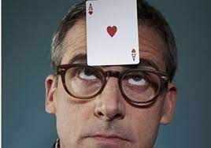
Cooperative Card Guessing

Slide 2
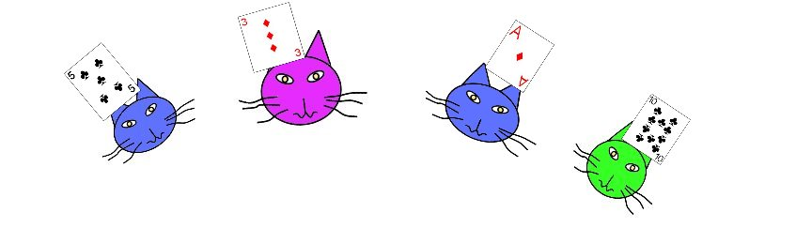
A Guessing Game
Each player draws a card from a standard deck and holds it up to their forehead
Each player can see all other cards, but not their own
Each player privately guesses their card value (not suit).
I think I have a 3
I think I have a 7
I think I have a 2
I think I have a Jack

Slide 3
A Guessing Game
Each player draws a card from a standard deck and holds it up to their forehead
Each player can see all other cards, but not their own
Each player privately guesses their card value (not suit).
Everyone wins/loses together:
If any player gets it right, then everyone wins. If every player gets it wrong, then everyone loses.
I think I have a 3
I think I have a 7
I think I have a 2
I think I have a Jack

Slide 4
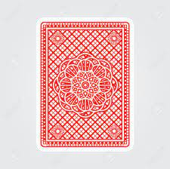

A Guessing Game
Each player draws a card and holds it up to their forehead, everyone guesses their card value, if anyone gets it right then everybody wins.
You are in a 13-player game.
What strategy should your team play to maximize chances of winning?
…

Slide 5
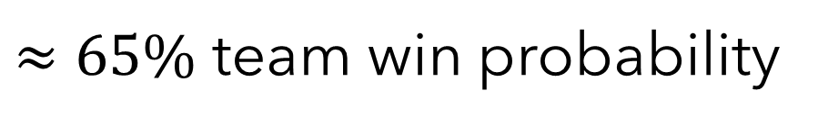
A Guessing Game
Strategy 1:
Everyone guesses randomly.
$≈65\%$ team win probability
…

Slide 6
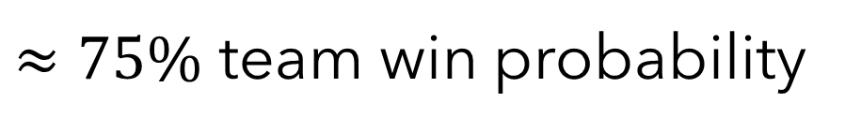
A Guessing Game
Strategy 2:
Everyone sees up to 12 card values held by their teammates.
Pick a random card value among those not held by any teammates.
$≈75\%$ team win probability
…

Slide 7
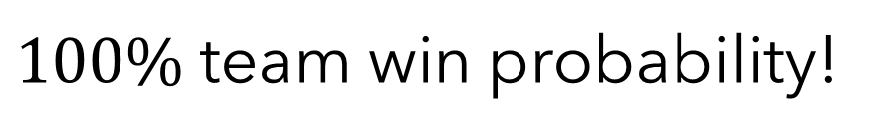
A Guessing Game
Strategy 3:
…
$100\%$ team win probability!
…

Slide 8

Interpret the 13 possible card values as numbers 1 to 13
A=1, J=11, Q=12, K=13
7
3
12
4
9
1
11
7
10
2
13
6
4

Slide 9
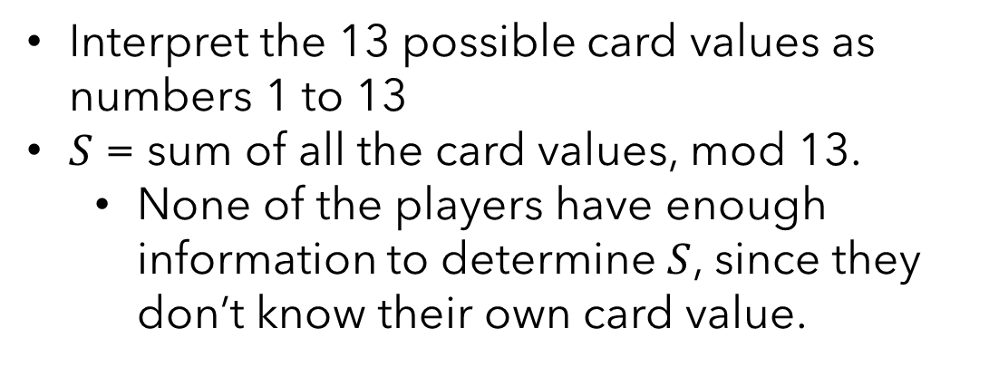
Interpret the 13 possible card values as numbers 1 to 13
$S$ = sum of all the card values, mod 13.
None of the players have enough information to determine $S$, since they don’t know their own card value.
1
7
10
2
13
6
4
S=11
7
3
12
4
9
11

Slide 10
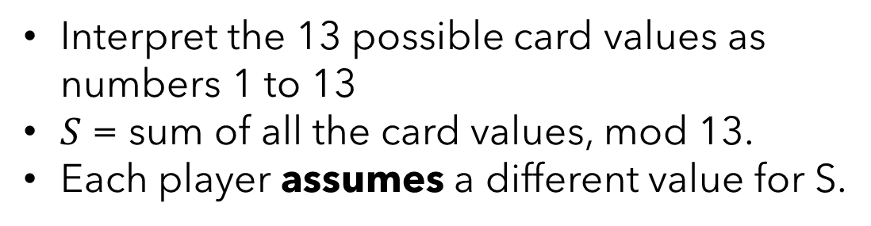
Interpret the 13 possible card values as numbers 1 to 13
$S$ = sum of all the card values, mod 13.
Each player assumes a different value for S.
Assume S=1
…
Assume S=11
Assume S=12
Assume S=0
1
7
10
2
13
6
4
S=11
7
3
12
4
9
11

Slide 11
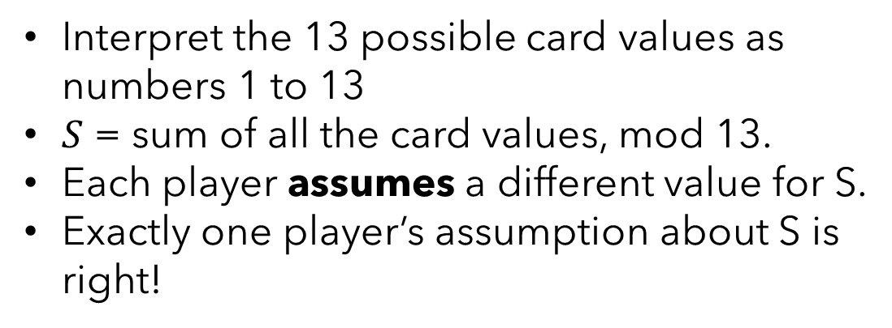
Interpret the 13 possible card values as numbers 1 to 13
$S$ = sum of all the card values, mod 13.
Each player assumes a different value for S.
Exactly one player’s assumption about S is right!
Assume S=1
…
Assume S=11
Assume S=12
Assume S=0
1
7
10
2
13
6
4
S=11
7
3
12
4
9
11

Slide 12
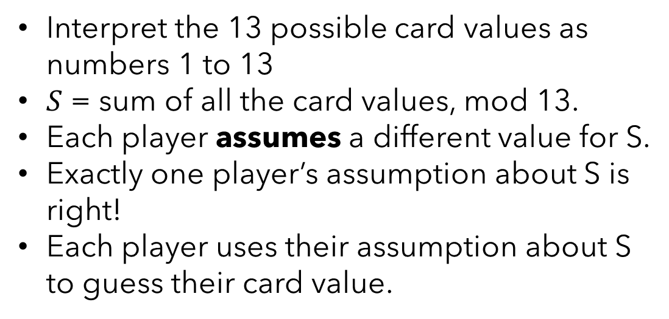
Interpret the 13 possible card values as numbers 1 to 13
$S$ = sum of all the card values, mod 13.
Each player assumes a different value for S.
Exactly one player’s assumption about S is right!
Each player uses their assumption about S to guess their card value.
Assume S=11
$$7+3+12+4+9+1+11+7+10+2+13+MYCARD+4≡11 (mod 13)$$
1
7
10
2
13
6
4
S=11
7
3
12
4
9
11

Slide 13
Interpret the 13 possible card values as numbers 1 to 13
$S$ = sum of all the card values, mod 13.
Each player assumes a different value for S.
Exactly one player’s assumption about S is right!
Each player uses their assumption about S to guess their card value.
Assume S=11
$$7+3+12+4+9+1+11+7+10+2+13+MYCARD+4≡11 (mod 13)$$
$$MYCARD≡6 (mod 13)$$
1
7
10
2
13
6
4
S=11
7
3
12
4
9
11

Slide 14

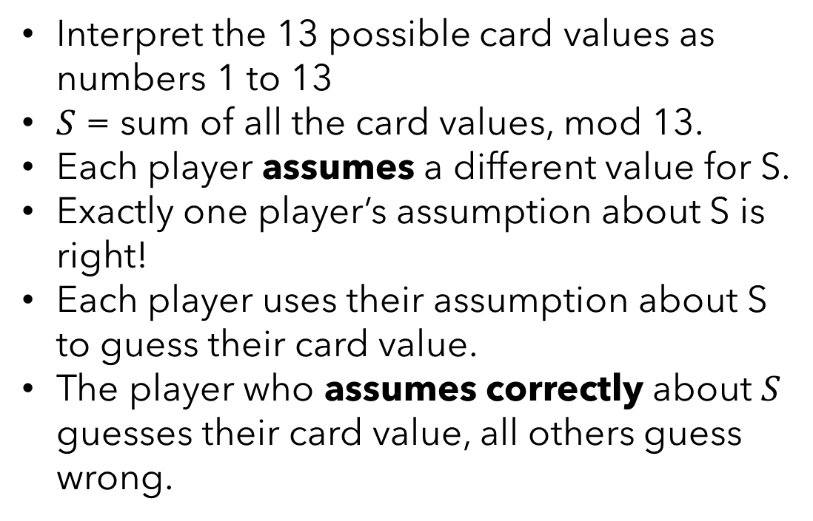
Interpret the 13 possible card values as numbers 1 to 13
$S$ = sum of all the card values, mod 13.
Each player assumes a different value for S.
Exactly one player’s assumption about S is right!
Each player uses their assumption about S to guess their card value.
The player who assumes correctly about $S$ guesses their card value, all others guess wrong.
1
7
10
2
13
6
4
S=11
7
3
12
4
9
11

